Slide 1
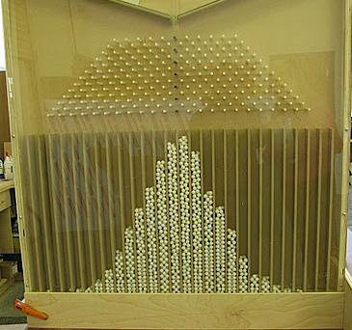
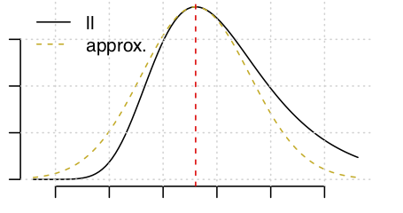
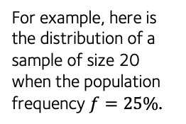

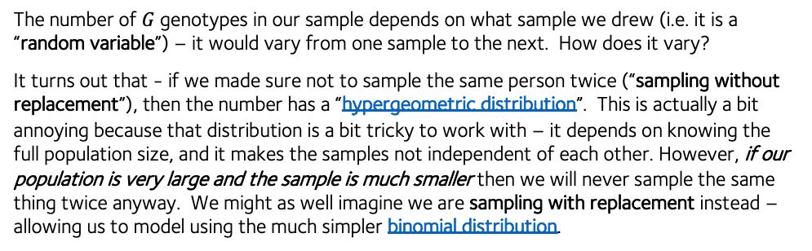


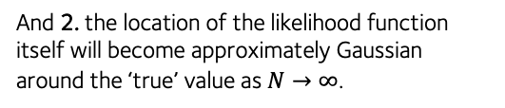
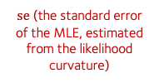










Sampling and asymptotics cheatsheet
Here is another way to think of sampling – via a Galton board:
Gavin Band, WHG GMS Programme 2021
We drop marbles in at the top
Suppose we have a big bag of things – for example, a population of people, with a particular genotype $G$ that occurs at frequency $f$:
At each level the ball ‘samples’ either a left or a right.
Number of possible routes is given by Pascal’s triangle:
Population
E.g. of genotypes with frequency f
And suppose we draw a sample of $N$ things from the population.
1
1 1
1 2 1
1 3 3 1
1 4 6 4 1
etc.
After a while the marbles draw a binomial distribution:
Sample of size N
The number of possible routes ending up in each box is given by Pascal’s triangle – in other words, they are the binomial coefficients. Hence the name!
The number of $G$ genotypes in our sample depends on what sample we drew (i.e. it is a “random variable”) – it would vary from one sample to the next. How does it vary?
It turns out that - if we made sure not to sample the same person twice (“sampling without replacement”), then the number has a “hypergeometric distribution”. This is actually a bit annoying because that distribution is a bit tricky to work with – it depends on knowing the full population size, and it makes the samples not independent of each other. However, if our population is very large and the sample is much smaller then we will never sample the same thing twice anyway. We might as well imagine we are sampling with replacement instead – allowing us to model using the much simpler binomial distribution.
The most crucial fact in all of statistics is that, as we let the number of samples get large, the distribution above becomes approximately Gaussian:
A Gaussian or normal density
with $\text{mean} = Nf$
and $\text{variance} = Nf(1−f)$
This famous fact is known as the central limit theorem. An important consequence is the asymptotic theory of likelihoods explained below.
This is in fact how tools like glm() compute their output – here’s an example:
$$\text{number} \text{of} G \text{genotypes} \text{in} \text{the} \text{sample} \sim \text{binomial}(N,f)$$
Only depends on the sample size and the true frequency $f$
This is the situation we’re often in in genetics – we have a small sample from a large population, and we would like to make statements about the population by looking at the sample.
fit = glm( Y ~ X, data = data, family = "binomial" )
> summary(fit)$coefficient
Estimate Std. Error z value Pr(>|z|)
(Intercept) -1.1155710 0.2409409 -4.630061 3.655588e-06
X -0.2491656 0.2115801 -1.177642 2.389394e-01
For example, here is the distribution of a sample of size 20 when the population frequency $f=25\%$.
The mean or expected value is… right where you’d expect it to be ($20/4 = 5$).
$\hat{β}$ (the maximum likelihood estimate or MLE)
$\text{se}$ (the standard error of the MLE, estimated from the likelihood curvature)
$$z\text{ = }β/\text{se}$$
(the z-score)
$$P=\text{pnorm}\left(−|z|\right)×2$$
(the P-value)
But when N = 20, there is quite a bit of sampling noise around the mean.
Interpretation: our estimate of $β$ is -0.25, but since P = 0.23 this is consistent with a true effect of zero and a nonzero observed effect due to random sampling of the outcome varianble $Y$.
The central limit theorem implies that many likelihood functions ‘become gaussian’ as the amount of data grows. Specifically:
Moreover 3. these gaussians have the same variance!
The likelihood function…
$$\text{Likelihood} \text{function}\text{:}$$
$$P\left(data | β=x\right)∝N\left(x;\hat{β},\frac{I}{N}\right)$$
1. the likelihood function will approximate a Gaussian density (up to a constant) as $N→∞$.
…becomes approximately Gaussian as N grows
$$\hat{β} \sim N\left(\text{true} β,\frac{I}{N}\right)$$
These have the same variance, scaling like $1/N$.
(Here $I$ is some value that doesn’t depend on the data or parameters.)
MLE estimate distribution:
And 2. the location of the likelihood function itself will become approximately Gaussian around the ‘true’ value as $N→∞$.
Conclusion 1: often we only need to report the maximum likelihood estimate and its std. error.
$\hat{β}$ = the maximum likelihood estimate, becomes approximately gaussian distributed around ‘true’ $β$ as N grows
Conclusion 2: the standard error can be read off from the likelihood function.
(This is indeed how standard errors and P-values in functions like lm() and glm() are often computed.)
This is referred to as ‘asymptotic local normality’ and ‘Le Cam’ theory. For them to work the likelihood must be smooth, the ‘true $β$’ should be in the interior of parameter space, and the data should have some level of independence.

